Slide 1

Alternative possibilities – Part 1:
What does it mean to transcend race?
Carlos Hoyt
Thursday, August 13, 2020
7:00 PM 8:00 PM

Slide 2
“We cannot merely critique identity politics, we must forge a new and better vision which emphasises what unites us whilst honouring and respecting our differences.
This can only be done when freedom of speech, free exchange of ideas and the pursuit of truth are at the heart.
We cannot solve difficult issues, without having frank, honest and difficult conversations.” - Inaya Folarin Iman
And we cannot disabuse people of problematic core convictions and commitments unless we fully anticipate and prepare for powerful resistance.

Slide 3
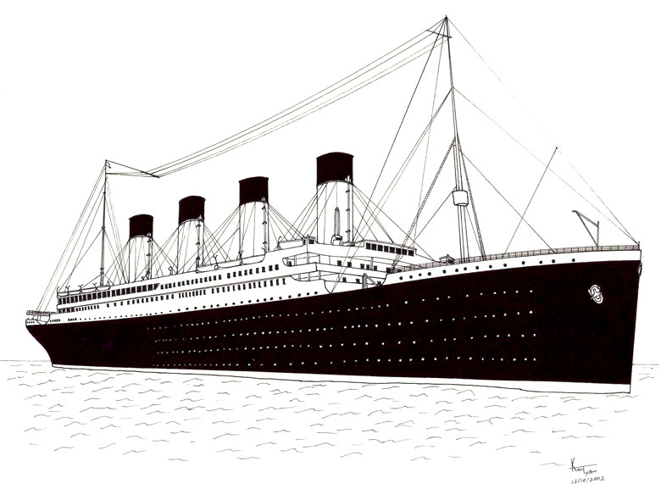
If I could dispense just one morsel of advice to mind changers, it is to spend less time trying to convince individuals of a new perspective, and more time trying to understand and thereby neutralize the resistance (Gardner, 2008 p.xii)
A Beautiful Idea….
Correct is not the same as compelling

Slide 4


Slide 5
What is the meaning and origin of race?
What does it mean to challenge the idea of race – to transcend race?
What does it entail for a person to refuse to accept his or her racial designation?
How can we destabilise the ideology and belief system of race?
--------------------------------------------------------------------------------------
What possibilities for human relationships exist beyond the boundary of race?
Is the idea of racial difference more important than that of universal
humanity?
Is ‘race’ and racial essentialism more important than individual freedom?

Slide 6
What is the meaning and origin of race?

Slide 7
Francois Bernier, 1670, “A New Division of the Earth,” first promoter of lethal delusions about human differences.
“Geographers up to this time have only divided the earth according to its countries or regions.
The remarks which I have made upon men during all my long and numerous travels, have given me the idea of dividing it in a different way.”
Are you crazy, Francois?

Slide 8
Race is something for which we have a prepared susceptibility. This does not mean that racial ideas are incorrigible or that they are themselves biologically determined. Because something emerges out of an inborn susceptibility does not mean that we have no control over it or that the thing itself is innate. . . . Virtually all humans are born with susceptibilities to contract smallpox and tuberculosis. The diseases themselves are not innate; the susceptibilities to contract them are. – Hirschfeld, 1998

Slide 9
By “racial worldview” I simply mean believing and acting in accordance with the social convention that people can and should be regarded as members of one (or more) of a handful of nebulous, restrictive, contradictory, and conflicting subspecies, called races. - Smedley, 2016
How’s that been working for us?

Slide 10
Racial equality is an oxymoron.
The notion of race is fundamentally and essentially about inequality between racialized groups.

Slide 11

Modern human genetic variation does not structure into phylogenetic subspecies (geographical “races”), nor do the taxa from the most common racial subclassifications of classical anthropology qualify as “races.”

Slide 12
But hold on a minute..

Slide 13
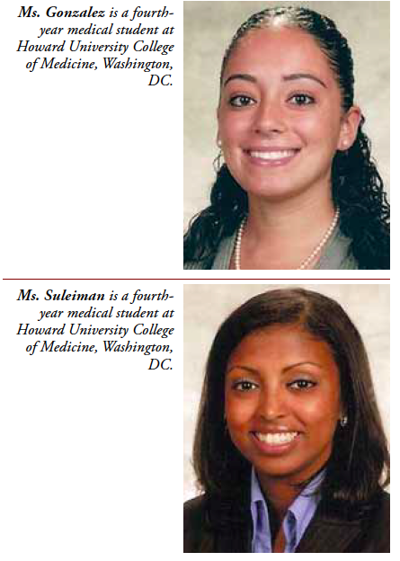
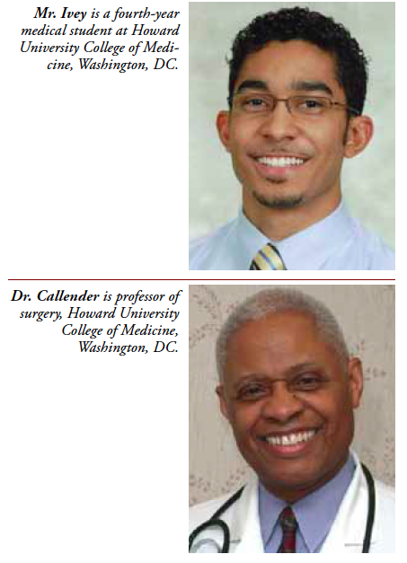
Sept. 2011

Slide 14
If only those who know best what an absurdity the concept of
race is would help the rest of us detach from our practice
of racialization….

Slide 15
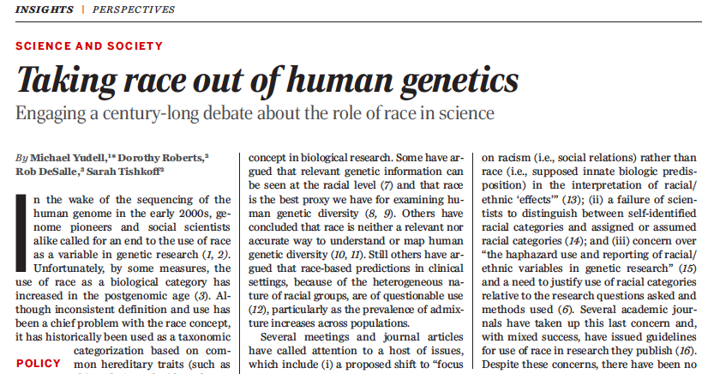
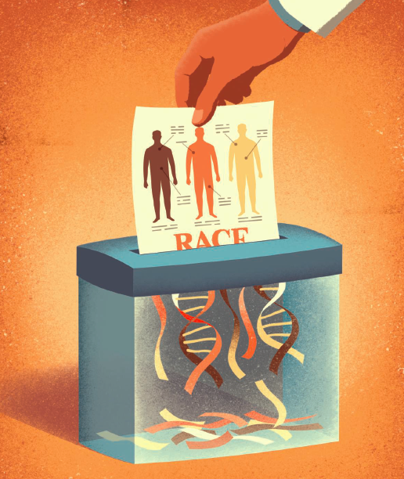
Feb. 5, 2016

Slide 16
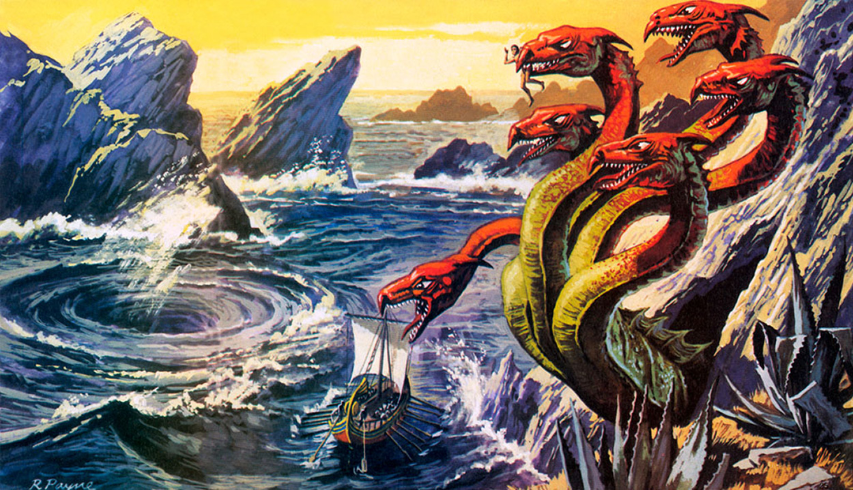
Taking Race Out Of Human Genetics & Memetics
We Can’t Achieve One Without The Other

Slide 17
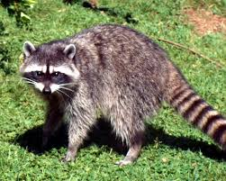
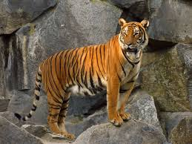
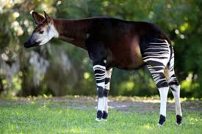
Proponents will argue race is a placeholder—a crude marker of variation that might as well be used until better markers (genetic or environmental) for differential responses are identified and cost effective genetic screening technologies become available.
But scientifically, race is a meaningless marker of anything. Pooling people in race silos is akin to zoologists grouping raccoons, tigers and okapis on the basis that they are all stripey.
-NATURE BIOTECHNOLOGY VOLUME 23 NUMBER 8 AUGUST 2005

Slide 18
2. What does it mean to challenge the idea of race
– to transcend race?

Slide 19
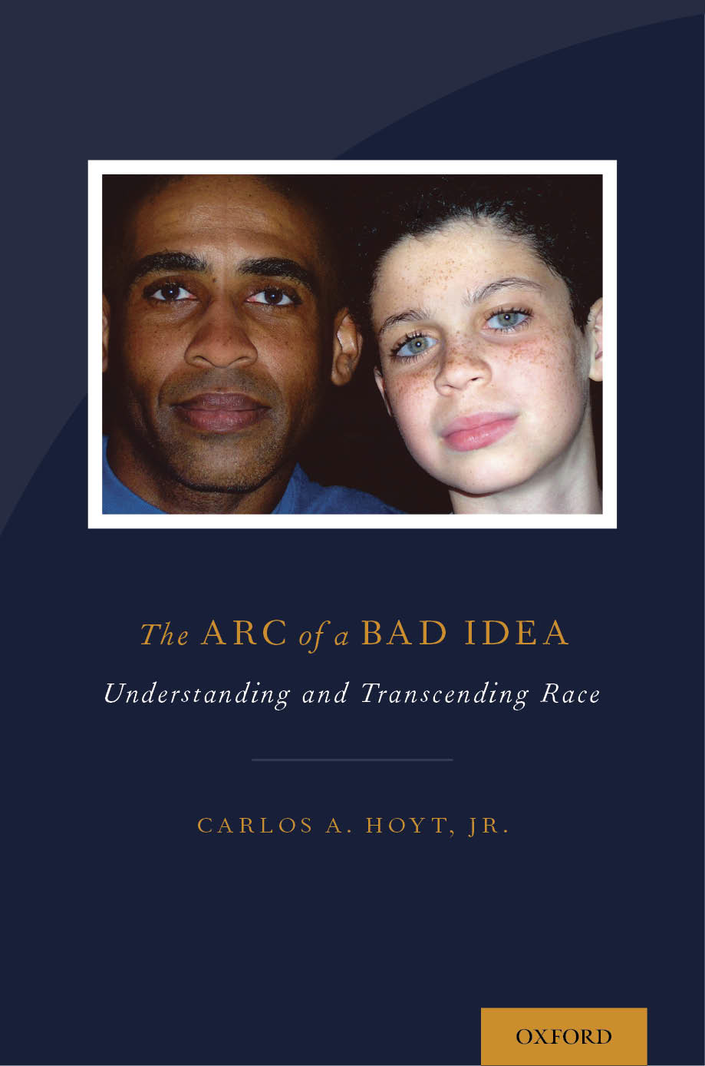

Slide 20
Transcend
&
Return

Slide 21
I really believe that if the political leaders of the world could see their planet from a distance of 100,000 miles their outlook could be fundamentally changed. That all-important border would be invisible, that noisy argument silenced. The tiny globe would continue to turn, serenely ignoring its subdivisions, presenting a unified façade that would cry out for unified understanding, for homogeneous treatment. The earth must become as it appears: blue and white, not capitalist or Communist; blue and white, not rich or poor; blue and white, not envious or envied. – Michael Collins, Apollo astronaut

Slide 22
You develop an instant global consciousness, a people orientation, an intense dissatisfaction with the state of the world, and a compulsion to do something about it. From out there on the moon, international politics look so petty. You want to grab a politician by the scruff of the neck and drag him a quarter of a million miles out and say, “Look at that, you son of a bitch.” – Edgar Mitchell, Apollo astronaut

Slide 23
My journey has taken me past constructions of race, past constructions of mixed race, and into an understanding of human difference that does not include race as a meaningful category. -Spencer, 2002
Notes:
This statement by anthropologist, Rainier Spencer, was one of the inspirations for my research. It rendered back to me my own consciousness about race and racial identity, and it encouraged me to believe that there were others who felt as I did.
How do I find these people? What might I learn from them about their journey to such an unusual and unexpected identity destination.?

Slide 24
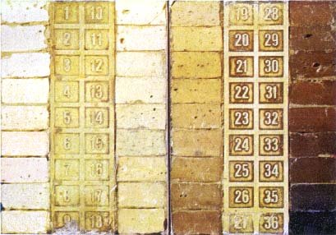
WHO ARE THE RACE TRANSCENDERS?
A Qualitative Exploration of Factors Contributing to Non-racial Identity Development in Individuals Commonly Ascribed to
Black/African American, Biracial or Multiracial Identity Groups
Notes:
Thank you for attending this presentation.
I am very eager to learn your thoughts about the material I’m going to share with you.
And I promise to explain the image you see.
Before we begin, please help yourself to some cookies, if you’d like. I hope that between the cookies and my defense presentation, one way or another, you might walk away with something worthwhile.
Also before we begin, I want to thank the members of my dissertation team.
Stefan Krug, who has not only been a terrific source of support, guidance and wisdom in my work on this project, but also along the way as an exceptional teacher.
Audrey Smedley, author, of Race in North America, book that inspired my interest in this study and a book that I continue to learn from after years of reading and re-reading. I was overjoyed and then quite intimidated when Audrey generously agreed to serve as my outside reader. Her perspective, voluminous knowledge, and incisive questions about my work made it much better than it would have been without her guidance.
I had the great good fortune of taking several courses with Ruth. Every occasion was enriching, surprising, and fun. I’ll share just one story of the time in a class discussion on feminism when, because I had become very comfortable with Ruth, I asked the following question: “Ruth, can men be feminist?” of course this was, at best, a rhetorical question, and at worst, a very scantily clad challenge and provocation. And I’m pretty sure Ruth knew that.
There was a wonderful pause in the room after I presented my question/challenge/provocation. It was ended when Ruth finally responded saying “Well, men can be allies.”
If you haven’t yet gathered it from this story, let me make it clear, I completely disagree with that position, and I absolutely loves being able to disagree with my teacher and mentor – on that matter and others as well. I will always cherish the memory of every good talk I was part of because of Ruth’s remarkable ability to facilitate meaningful dialogue.
When Ruth agreed to be the chair of my committee, I felt rescued and in the safest hands possible. Not safe from disagreement or challenge, but safe to work through it all with one of the best allies I’ve ever had.

Slide 25
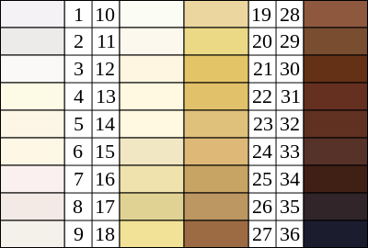
Felix Von Luschan's chromatic scale for classifying skin color. Used extensively throughout the first half of the 20th century in race studies. Problematic because it was very inconsistent. Largely abandoned by the early 1950s.
Can you find your skin color here? Can you find your identity here?
Notes:
Von Luschan's chromatic scale named after its inventor, Felix von Luschan (1854-1924 Austrian doctor and anthropologist) was a method of classifying skin color. The equipment consisted of 36 opaque glass tiles which were compared to the subject's skin, ideally in a place which would not be exposed to the sun (such as under the arm). The von Luschan scale was used extensively throughout the first half of the 20th century in race studies and anthropometry. However, it was considered problematic, even by its practitioners, because it was very inconsistent, and it was largely abandoned by the early 1950s.
The literature on Von Luschan leaves it unclear as to whether or not he was a racist – in a mean, capital “R” way. My use of his chromatic scale is as a wonderful reminder of how obsessed we are with perceptible differences between people and how prone we are to load up those superficial differences with all manner of irrational and unjustifiable meanings.
Can you find your skin color up there?
Can you find your identity in there?

Slide 26
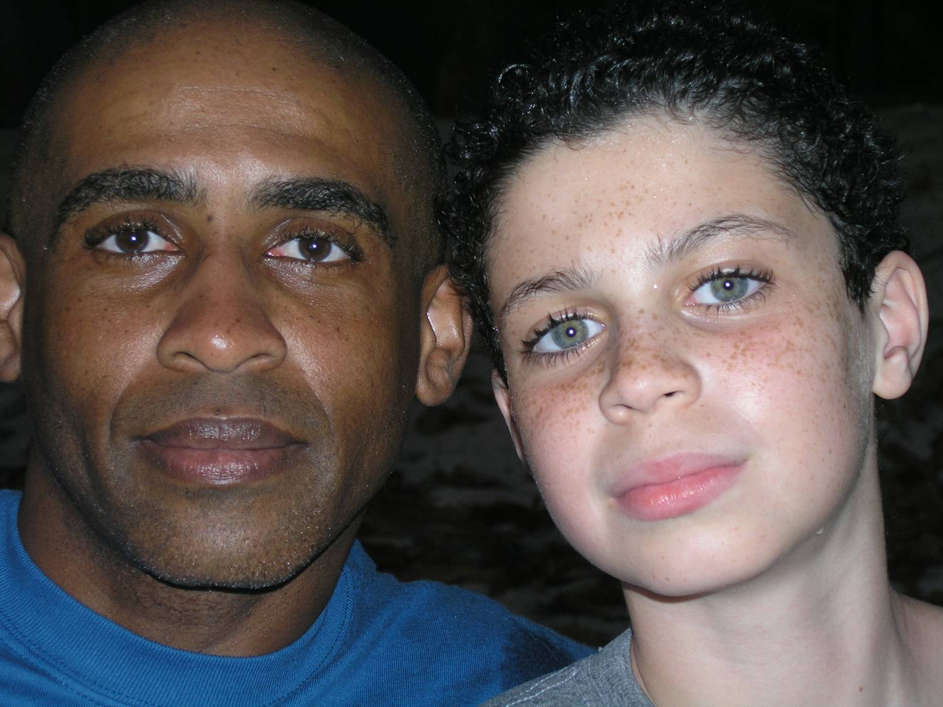
There is nothing more personal than identity
Do
we
l
ook
a
l
i
ke?
A
r
e
w
e
t
h
e
s
a
m
e
r
a
c
e
?
Who gets to decide?
What if we don’t want to be a race?

Slide 27
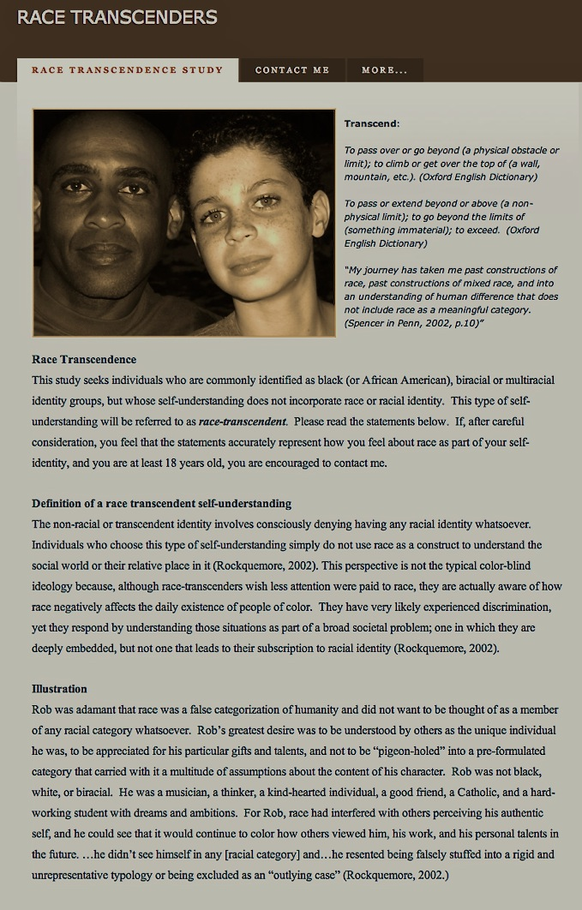
Much to my amazement, delight, and relief, people contacted me.
Notes:
Between June 2011 and December 2012, about 30 expressions of interests, out of which my ten participants emerged.
“Purposeful/Theoretical Sampling. Not probabilistic, but aimed at getting a deeper understanding of analyzed cases and underlying processes via comparison of types of participants.

Slide 28
A Voice Unheard – A View Unseen – A Better Vision of Identity

Slide 29
Precursor Research
Rockquemore’s study of biracial identity development
(1999 n=177)
Border – exclusively biracial. Neither black nor white. (~60%)
2. Singular – exclusively black or white. (~20%)
3. Protean – “Well, shit, it depends on what day it is and
where I’m goin’.”? (~6%)
4. Transcendent?! (~14%)
Notes:
60%
20%
6%
14%

Slide 30
Definition of a race transcendent self-understanding
Consciously deny having any racial identity whatsoever
Simply do not use race as a construct to understand the social world or their relative place in it
Don’t wish to be white, they are not bitter about being black; they simply disavow race as part of their sense of self
Not the typical color-blind ideology -- are aware of how race negatively affects the daily existence of people of color.
Very likely experienced discrimination, yet they respond by understanding those situations as part of a broad societal problem; one in which they are deeply embedded, but not one that leads to their subscription to racial identity.
-Rockquemore, 2002.

Slide 31
The Research Question
What are the factors that contribute to the development of a non-racial identity formation in individuals commonly ascribed to Black/African American, biracial or multiracial racial identity groups and who, as such, are expected to subscribe to a racial identity?
Notes:
I spent a lot of time thinking about what to call the absence of racial identity. One of my participants coined the term “a-racial” in an effort to give her orientation a name. In my writing a toggle between “non-racial” and “race transcendent.” I use ‘race transcendence” in the title and most often in my writing because it is the name that Rockquemore used to describe her participants who did not subscribe to race as part of their identity, and because it affirms something instead of connoting the absence of something.
.

Slide 32
It is assumed that in a society where racial group membership is emphasized, the development of racial identity will occur in some form in everyone.
-Tatum, 1992, p.9

Slide 33
Nowhere in racial identity theory is there room for or representation of a person who
Feels pretty good about him- or herself
Has no desire to be White
Has no desire to be Black
Has no desire to be racialized in any manner whatsoever.
Notes:
It was hard for me to believe I was the only person who might have a dystonic reaction to the idea of racial identity, so I started to search for voices that resonated with mine. I did not find resonance in what we are commonly taught about race and racial identity, and I received mostly polite incredulity, raised eyebrows, and advice to channel my energies elsewhere from most of the people I approached with this concern and interest.
Read Fischer and Moradi
Over time, however, I was able to find and start to collect viewpoints that questioned, sought to expand, and in some cases, defy the dominant discourse of racial identity.

Slide 34
3. What does it entail for a person to refuse to accept his or her racial
designation?

Slide 35
  Narratives of
  Race Transgression
  and
  Race Transcendence
Notes:
[Recruitment for the full study was done by means of theoretical sampling. Solicitation of participants was purposive, focusing on those who met the criteria and also guided by constant comparison of cases so that concepts and themes that emerged could be used to inform the selection of eligible participants whose accounts might be able to provide illuminating similarities or differences (Drauker, Martsolf, Ross & Rusk, 2007; Miles & Huberman, 1994).]
Participant Characteristics
Demographic categories used included sex, self-defined ethnicity, socioeconomic status (SES), occupation, level of education, current residence, place of birth, and citizenship. Other pre-interview information requested included self-description of appearance, how others most often classify the participant racially, and how long has the participant had a non-racial sense of self.
Five of the participants were female and five were male. One participant was below twenty years old. Three were between twenty and thirty years old. One participant was forty-two, and the remaining three participants were between fifty and sixty years old.
Six participants described themselves as members of the middle class; three as members of the lower-middle or middle-working class; and one as a member of the upper-middle class. One participant was in college; four completed college; one was in graduate school; three were PhDs; and one was an MD. Two participants were Fulbright Scholars; two were professors; one was human services professional; one a health care project manager; one a medical researcher; and one a mechanical engineer.
The participants hailed from Riverside, California; Pembroke Pines, Florida; Pensacola, Florida; Atlanta, Georgia; Cambridge, Massachusetts; Somerville, Massachusetts; Boston, Massachusetts; Henderson, Nevada; Greensboro, North Carolina; and Perth Australia. Three were not born in America. Of these three, one was born in Quebec Canada, one in Nova Scotia Canada, and one in South Africa. All but two of the participants were U.S. citizens. The two non-U.S. citizens represented Canadian and South African/Australian citizenships. Seven of the ten participants reported having a non-racial sense of self all of their lives. Three participants pointed to experiences that catalyzed a shift in self-identity consciousness towards race transcendence.

Slide 36
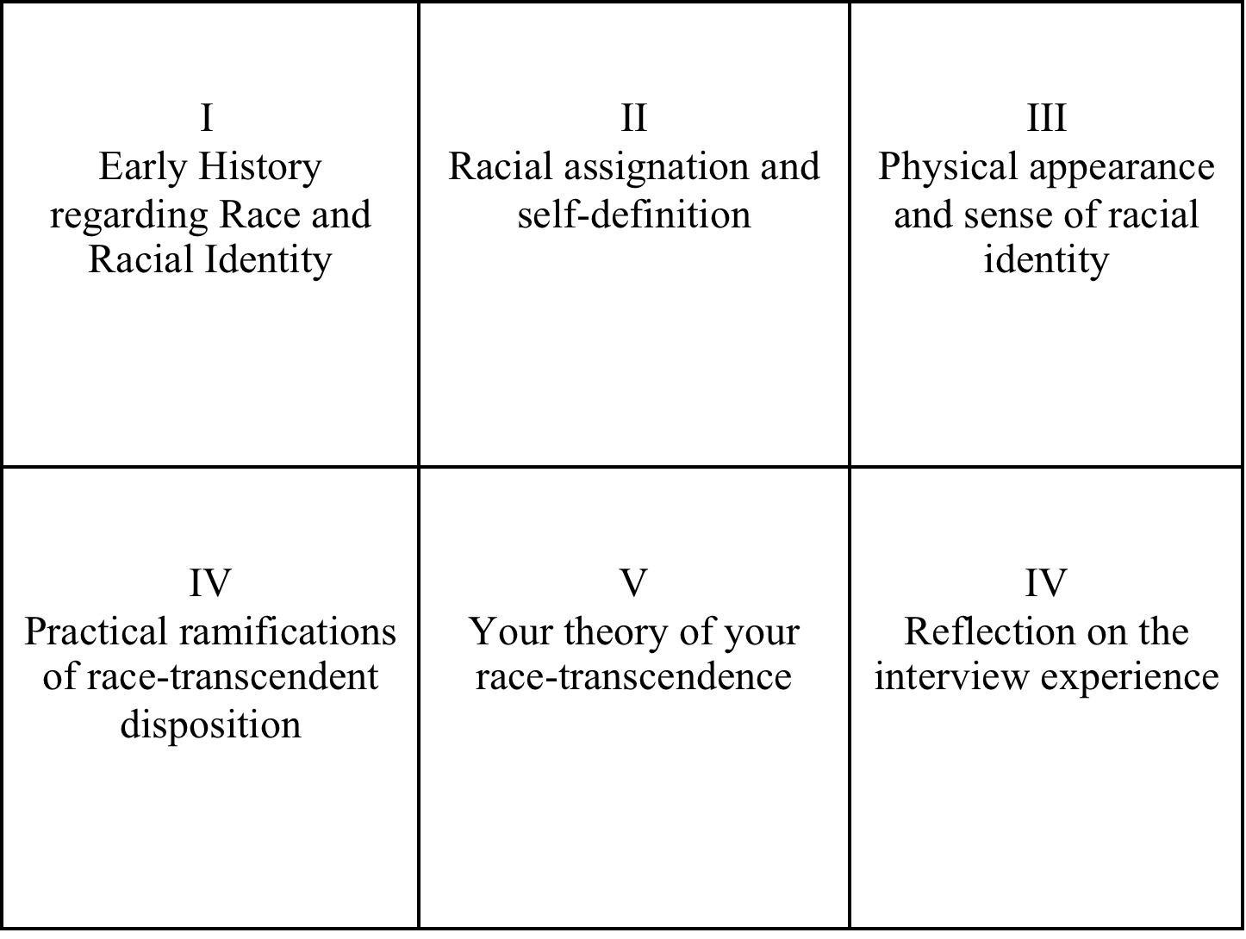
Semi-structured Interview Categories
Notes:
Appendix C
Semi-structured Open-ended Interview Questions and Interview Domains Matrix
(Questions will be used selectively depending on the course of the conversation)
At what age did you become aware of race?
Please tell me about any memorable experiences you had as a young person having to do with learning about race? What was the experience and how did you intepret it and make meaning of it?
Was the topic of race discussed in your family? (Explicitly, implicitely, by whom…)? If yes, what was said and how did you intepret and make meaning of what was said?
Did your parents try to shape your racial identity in any way? How did this play out and how did you accept, reject or modify the messages or teachings from your parents?
How would you describe your friends and friendship groups as a youngster?
Was race ever a topic of discussion among your friends? If so, what was the nature of the discussions and how did you interpret and make meaning out of the discussion content?
What sorts of attributions were made about races when you were young (positive or negative)? Did you agree, disagree, feel uncertainty or ambivalance about these attributions?
Were you aware of racial epithets when you were a youngster? How did you feel and think about your experience with racial epithets?
If you had romantic partners, what race did each identify with, if any?
What, if anything were you taught about race (formally or informally) at school? How did you interpret the teachings and make meaning of them? Did you accept, reject or modify them in your own mind?
How have others described you racially over your life and how do others describe you racially these days?
How have you described yourself racially over the course of your life?
Have you ever done anything to try to make yourself appear as if you were a member of a racial group?
Do you think there is anything about your physical appearance that factored into your non-race sense of self?
How does having a non-race sense of identity impact your life – how does it play out in how you actually live your life? (work, relationships, family life, politics, etc.)?
What, in your view, is the significance of having a non-race sense of self for society? What should society know about race transcendence and race transcenders?
Is there anything in particular that you would like people to know or understand about having a non-race identity?
Are there any important questions I did not ask?
Were any of the questions asked unclear or problematic in any way?

Slide 37
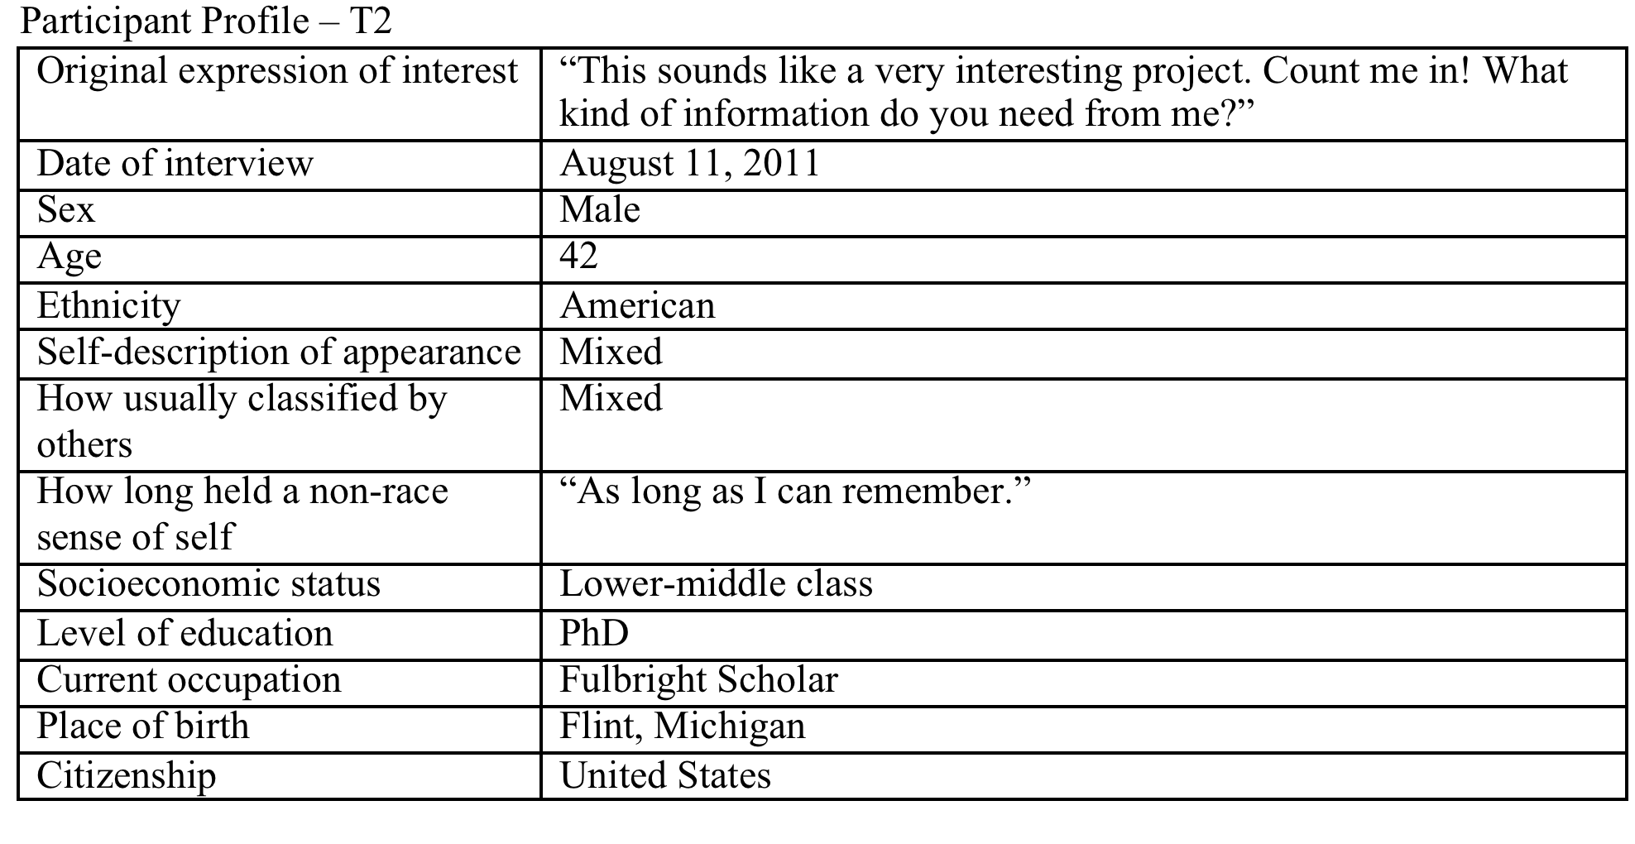
Notes:
What led you to become a race transcender?

Slide 38
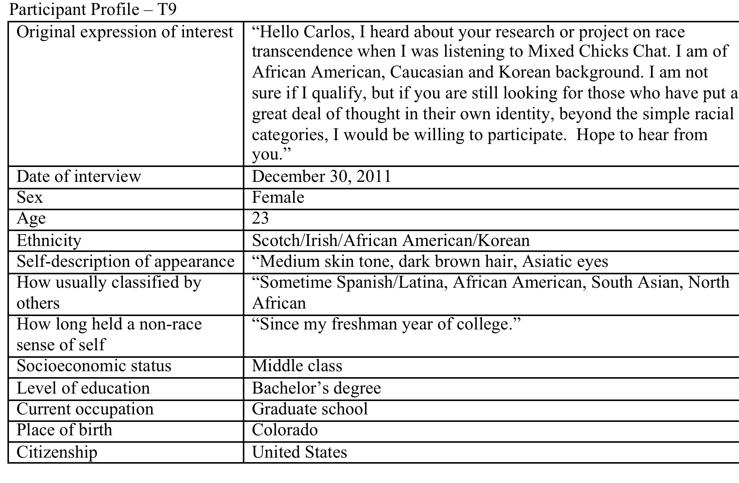
“So I’m used to people being so hypersensitive that I kind of have to, like, become numb to it. ‘cause you get so sick of it!”

Slide 39
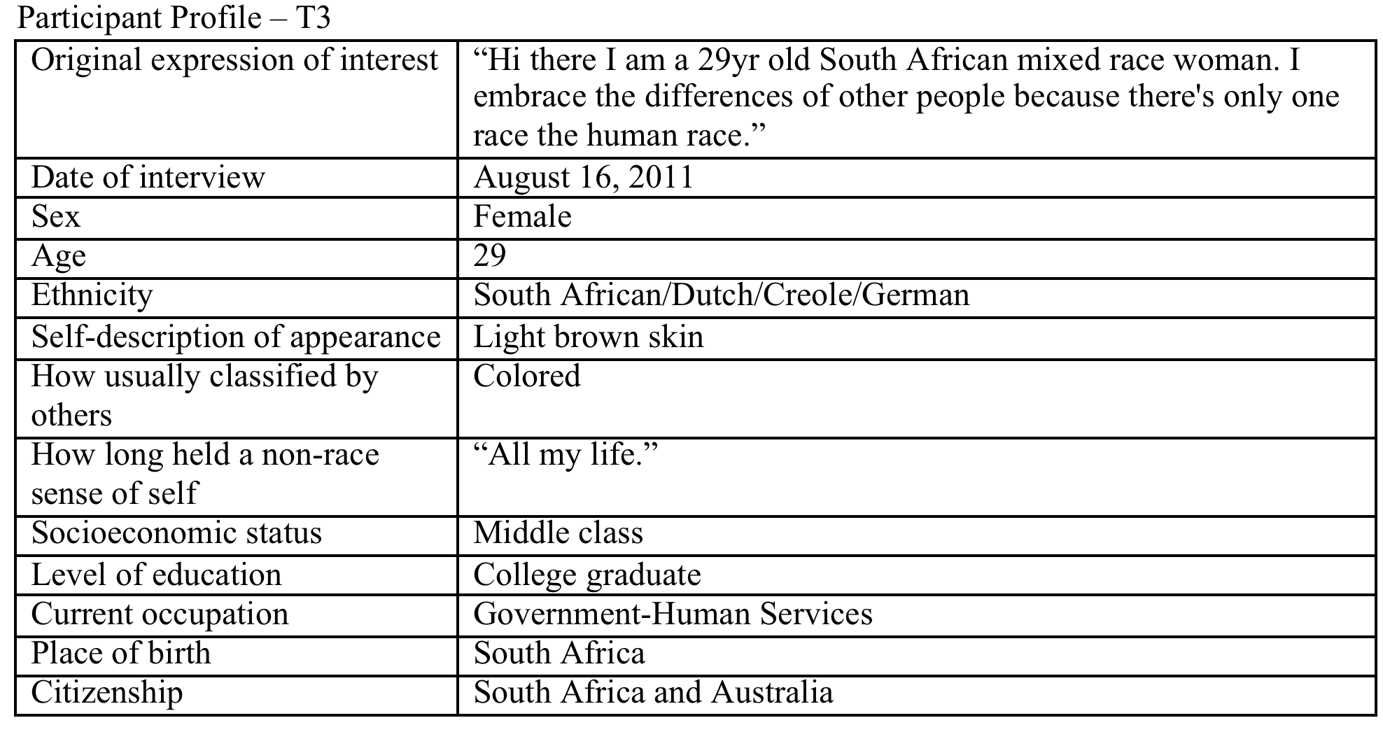
Notes:
How long have you had a non-racial sense of self?

Slide 40
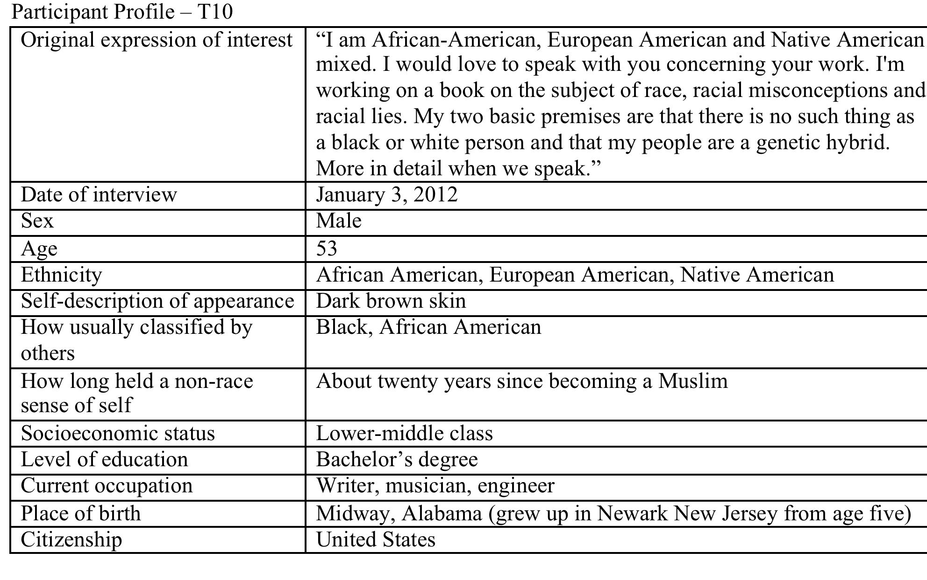
Notes:
Midway Alabama 1958 – still lynching African Americans for minor infractions and sins against society, “eyeball rape.”
Story from GM cotton field hand of black man being laid on train tracks

Slide 42
How can we destabilise the ideology and belief system of race?

Slide 43
The Nature of Race: How Scientists Think and Teach About Human Difference.
Constructivism and anti-essentialism have hardly conquered the academy (despite repeated claims to that effect), even in my highly particular sample where anthropologists make up half the interviewees. In contrast, the essentialist proposition that races are biologically grounded entities remains a compelling view for many contemporary scientists. - Ann Morning, 2011

Slide 44
Proponents will argue race is a placeholder—a crude marker of variation that might as well be used until better markers (genetic or environmental) for differential responses are identified and cost effective genetic screening technologies become available.
But scientifically, race is a meaningless marker of anything. Pooling people in race silos is akin to zoologists grouping raccoons, tigers and okapis on the basis that they are all stripey.
-NATURE BIOTECHNOLOGY VOLUME 23 NUMBER 8 AUGUST 2005

Slide 45
The common experiences shared in [the] black community provide the basis for ethnic unity and pride and for political and other organized efforts to protect and help its members.
The suggestion today that the one-drop rule is an arbitrary social construction that could be changed sounds to the black community like a dangerous idea.
American blacks now feel they have an important vested interest in a rule that has for centuries been a key instrument in their oppression. – J. Davis, 2008

Slide 46
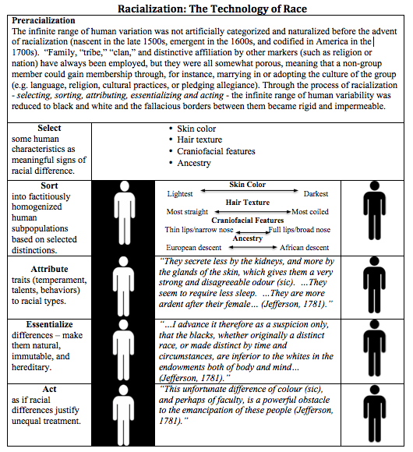

Slide 47
Racialization: The Technology of Race

Slide 48
Racialization: The Technology of Race
1. Select some human characteristics as meaningful signs of racial difference.

Slide 49
Racialization: The Technology of Race
1. Select some human characteristics as meaningful signs of racial difference.
2. Sort into subpopulations based on selected distinctions.

Slide 50
Racialization: The Technology of Race
1. Select some human characteristics as meaningful signs of racial difference.
2. Sort into subpopulations based on selected distinctions.
3. Attribute traits (temperament, talents, behaviors) to racial types.

Slide 51
Racialization: The Technology of Race
1. Select some human characteristics as meaningful signs of racial difference.
2. Sort into subpopulations based on selected distinctions.
3. Attribute traits (temperament, talents, behaviors) to racial types.
4. Essentialize differences – make them natural, immutable, and hereditary.

Slide 52
Racialization: The Technology of Race
1. Select some human characteristics as meaningful signs of racial difference.
2. Sort into subpopulations based on selected distinctions.
3. Attribute traits (temperament, talents, behaviors) to racial types.
4. Essentialize differences – make them natural, immutable, and hereditary.
5. Act as if racial differences justify unequal treatment.

Slide 53
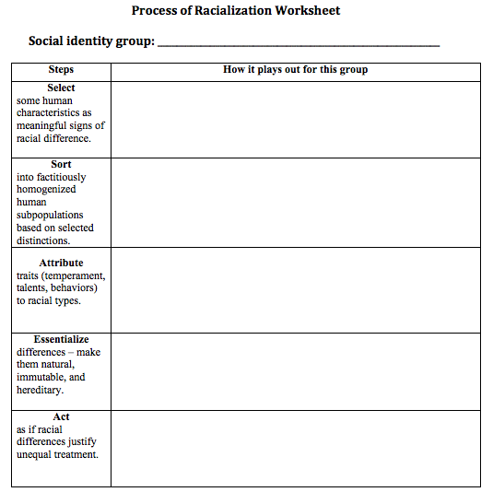

Slide 54
Airplane Passengers
Seating status
First class seat holders
v
Economy class seat holders
Seems to me those classies are calmer, more confident, better-looking, and just plain more appealing than the econers.
Oh, it’s not about money; this is deeper than circumstance. These differences are bone-deep, ancestry-deep, heritible, and immutable.
Why wouldn’t I prefer classies over econers when considering relationships, employment, residence, politics, etc.?

Slide 55
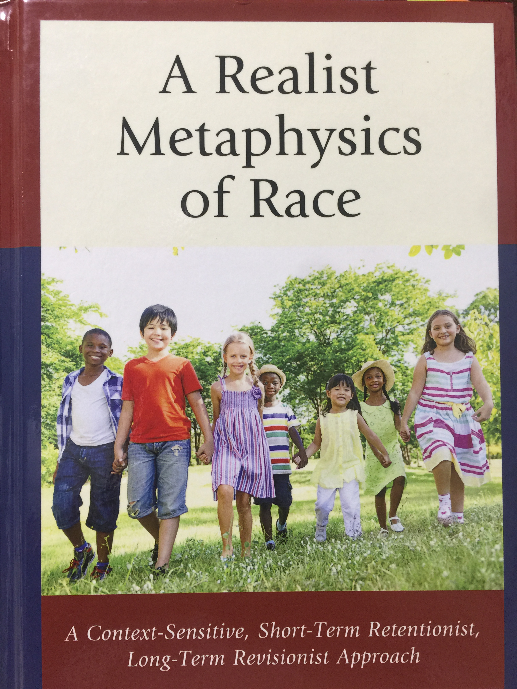
We might favor retaining racial categories, pretty much as they are (retentionism). We might seek to transform those categories without removing them entirely (revisionism). Finally, we might seek to eliminate any thought, language, or practices that involve race (eliminativism).

Slide 56
Possible Reactions to Race
Retentionism
Revisionism
Eliminativism
Correctivism
Commitment to counteracting the custom of racialization through self-discipline, education, advocacy, and counternarrative.

Slide 57
Racism resembles a gun. While mean racists use it to coerce or kill, kind racists help keep it loaded by supporting the underlying racial concepts.
-Donal Muir. Sociological Inquiry, August 1993

Slide 58
The Room of Racialization – The Racial Worldview
Non-racist Kind Racist Mean Racist

Slide 59
The Room of Racialization – The Racial Worldview
Non-racist Kind Racist Mean Racist

Slide 60
The Room of Racialization – The Racial Worldview
Non-racist Kind Racist Mean Racist

Slide 61
Prepare for powerful resistance
Sometimes people hold a core belief that is very strong. When they are presented with evidence that works against that belief, the new evidence cannot be accepted. It would create a feeling that is extremely uncomfortable, called cognitive dissonance. And because it is so important to protect the core belief, they will rationalize, ignore and even deny anything that doesn't fit in with the core belief. - Frantz Fanon, Black Skin, White Masks

Slide 62
“It's easier to fool people than to convince them that they have been fooled.”― Author uncertain
“I see no reason why I should be consciously wrong today because I was unconsciously wrong yesterday.”
– Supreme Court Justice Robert H. Jackson, 1948
The effect of the race transcendent perspective is not to deny the psychological or sociopolitical truth and power of race, but to be empowered to disengage from the hegemonic and seemingly inescapable racial worldview, gain the liberating insight that that detachment affords, and then re-engage with the idea of race in a new and enlightened way.

Slide 63
Discussion
What is the meaning and origin of race?
What does it mean to challenge the idea of race – to transcend race?
What does it entail for a person to refuse to accept his or her racial designation?
How can we destabilise the ideology and belief system of race?
--------------------------------------------------------------------------------------
What possibilities for human relationships exist beyond the boundary of race?
Is the idea of racial difference more important than that of universal
humanity?
Is ‘race’ and racial essentialism more important than individual freedom?

Slide 64
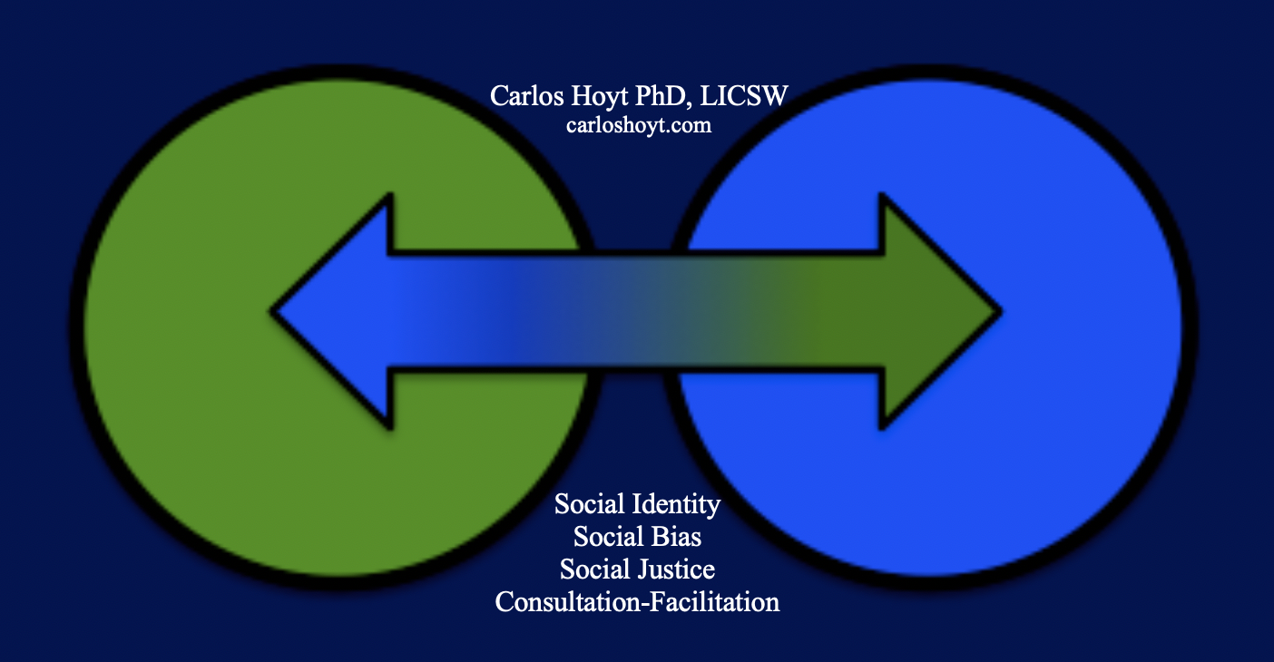
Thank you!

